Slide 1
Invisible Gender Discrimination in Food Delivery Industry
Wang Siding
Department of Philosophy

Slide 2
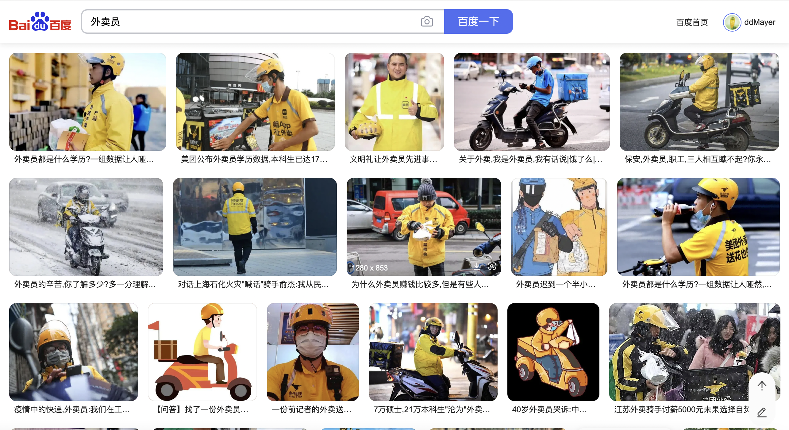
He must be a man...

Slide 3
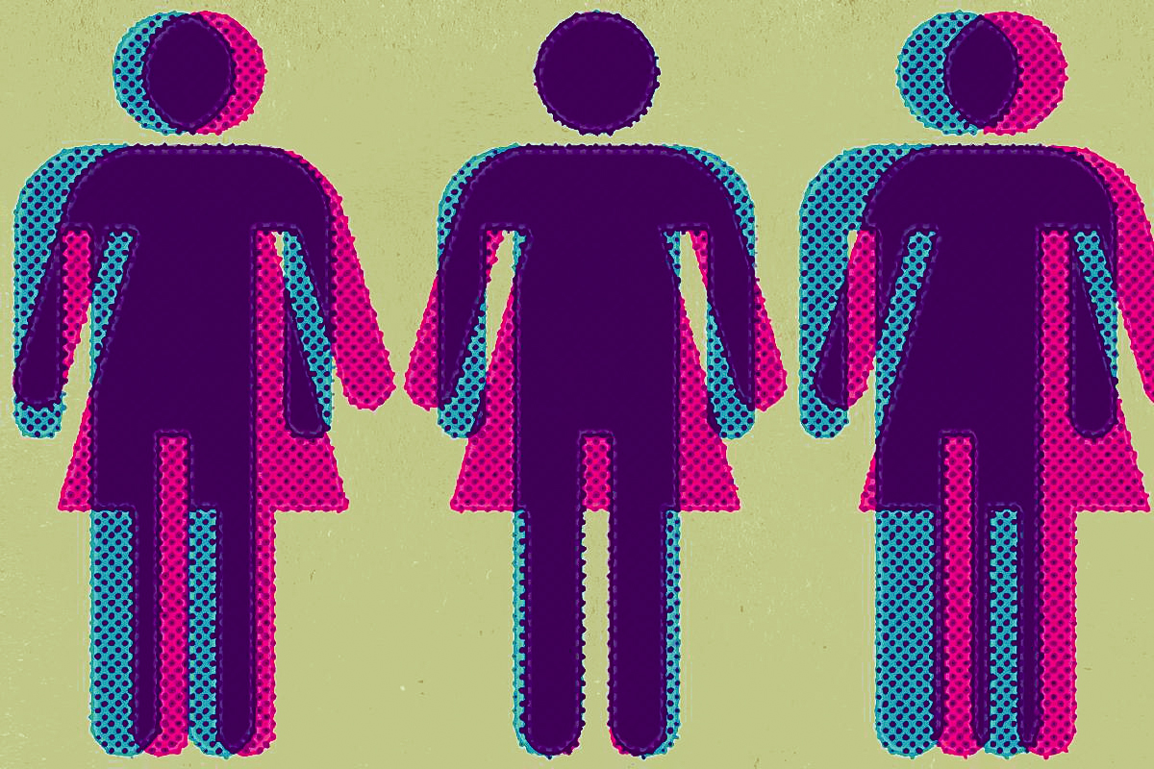


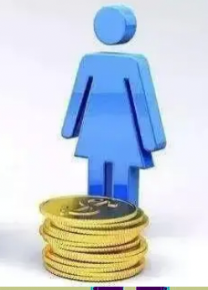
Gender Neutral?

Slide 4



algorithmic bias

Slide 5

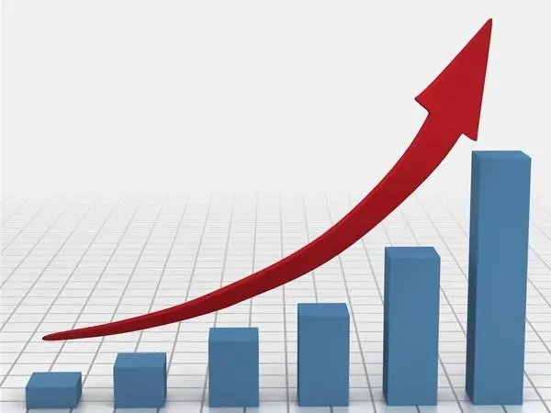
Isn’t it fair?

Slide 6
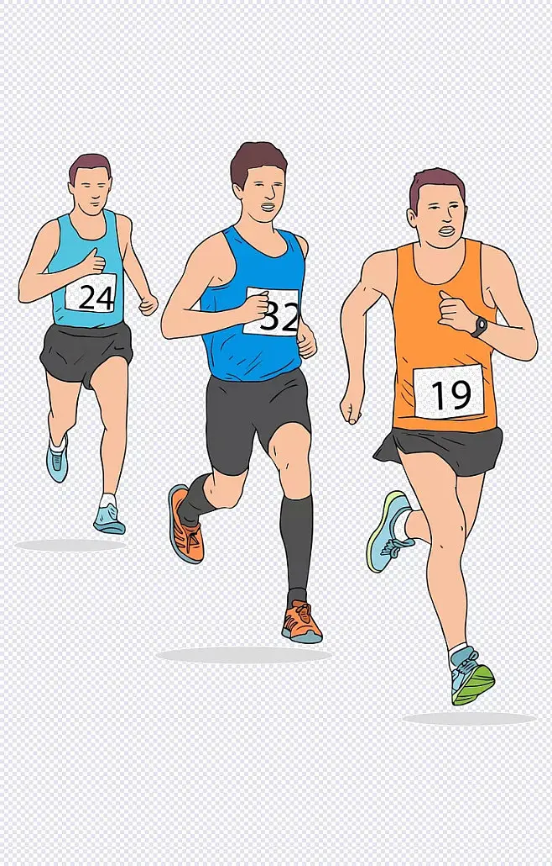
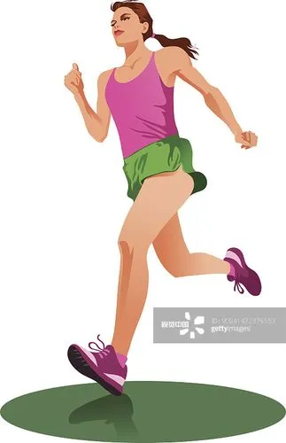
Notes:
To draw an analogy this scenario is like participating in a mens athletic competition when you are a woman, while your competitors keep getting stronger due to the involution mechanism. You still think it’s fair? The physical disadvantage of women is largely amplified by the seemingly non-discriminatory algorithm.

Slide 7
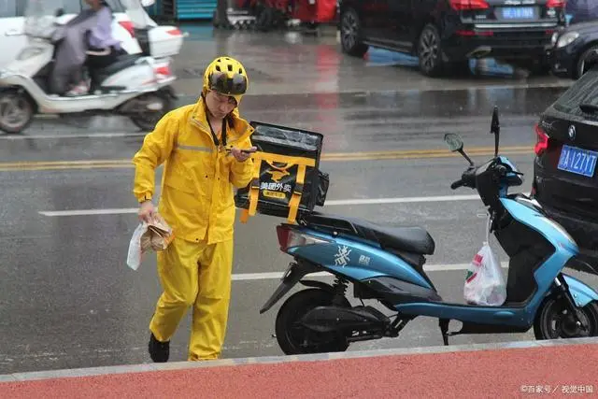


ideological gender bias

Slide 8
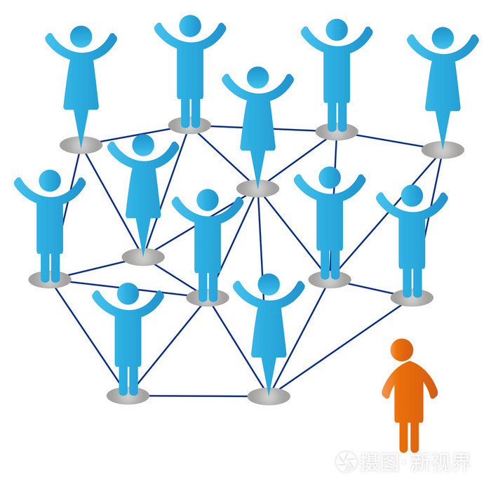
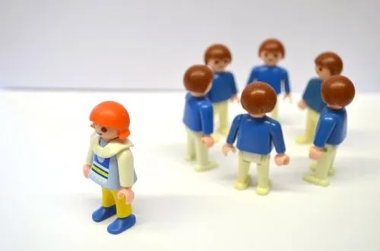
Exclusion

Slide 9
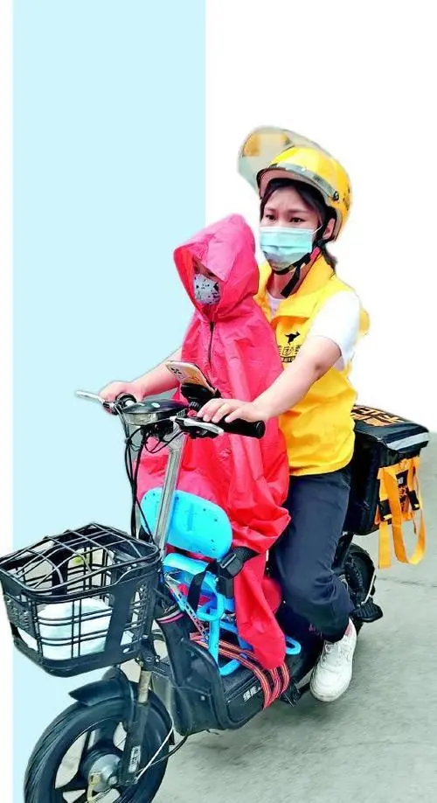

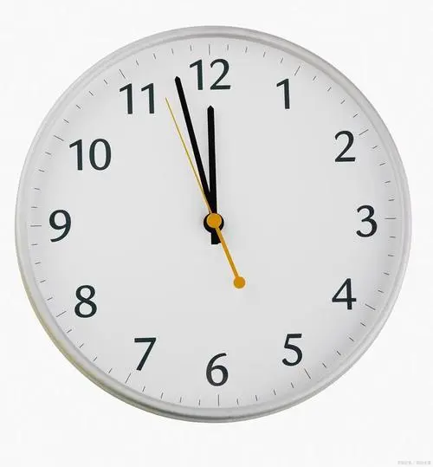
domestic duty

Slide 10
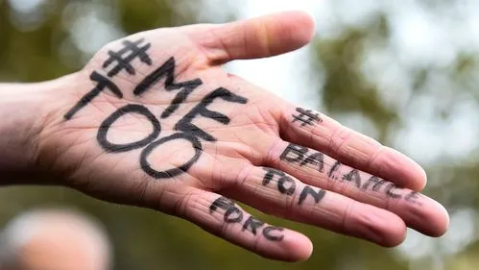
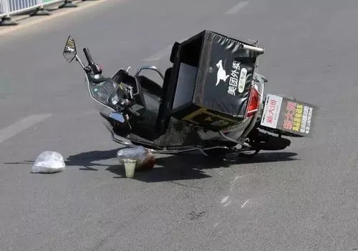
other issues

Slide 11



